Slide 1
Chapter 36

Slide 2
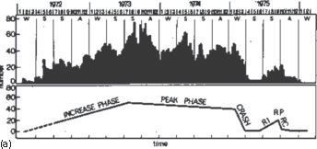
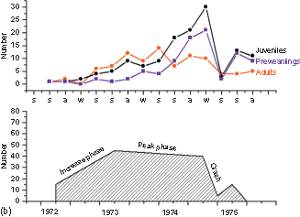
Figure 1 (a) Change in population density of a feral population of house mice in large outdoor enclosure. (b) Mortality of adult, juvenile, and preweanling house mice during the various phases of the population cycle.
(Revised figure from Van Oortmerssen and Busser 7)

Slide 3
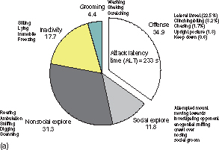
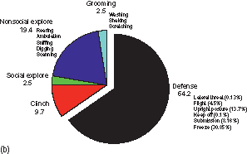
Figure 2 Behavioral profile of resident males WTG rats (a) and Wistar intruder rats (b) during a 10 min resident-intruder test.

Slide 4
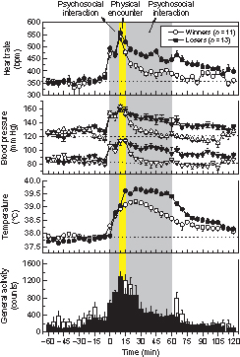
Figure 3 Changes in heart rate, blood pressure, and core body temperature in male rats during winning or losing a social interaction in a resident-intruder paradigm. The animals were provided with permanently implanted radio telemetry transmitters.

Slide 5
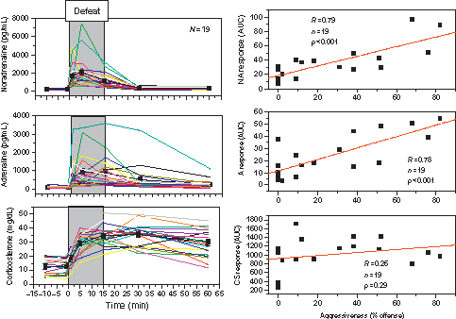
Figure 4 Individual time-response curves (AUCs) of plasma noradrenaline, adrenaline, and corticosterone responses to social defeat. The right-hand graphs show the relationship between the total neuroendocrine response (area under the curve, AUC) and the individual level of offensive aggressive behavior measured in the resident-intruder paradigm. Blood samples were collected using permanently implanted jugular vein cannula.

Slide 6
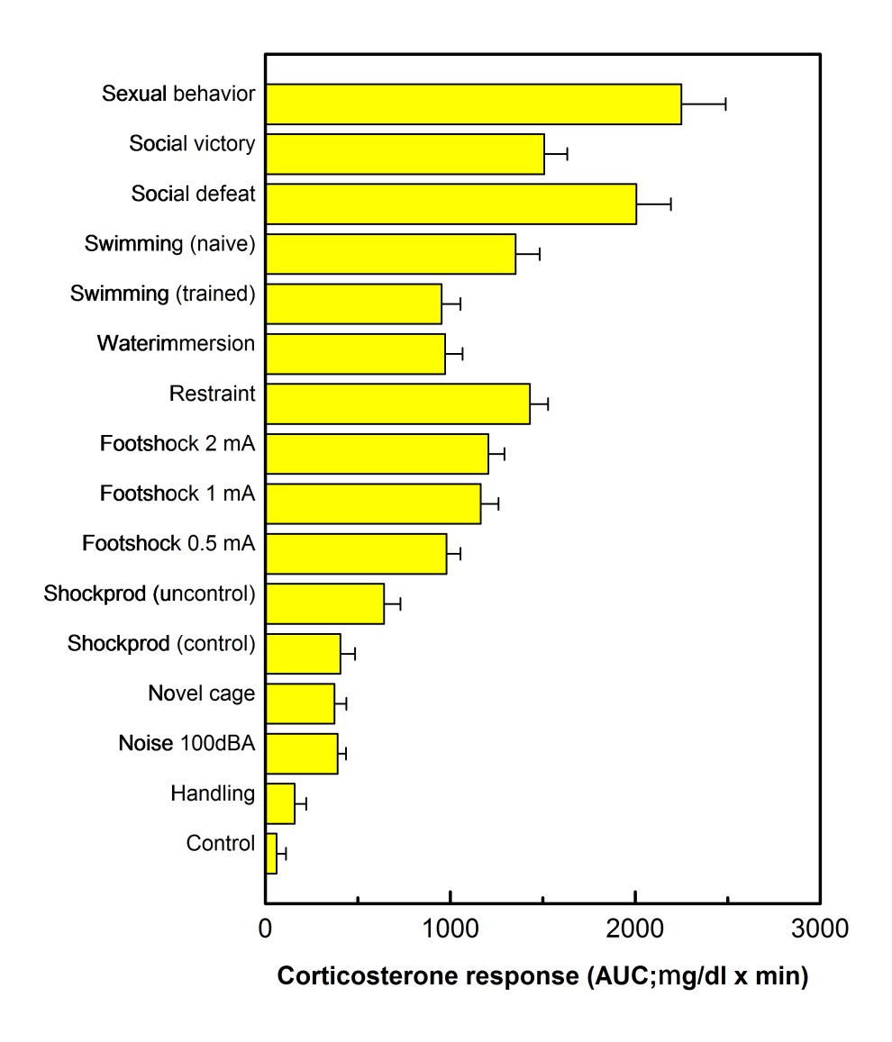
Figure 5 Plasma corticosterone responses of adult male Wistar rats to experimental stressor conditions, quantified as total area under the AUC. Each test consisted of a standardized series of baseline samples and a 15 min exposure to the stimulus followed by a recovery phase for the remaining hour. Blood samples were collected via a permanently implanted jugular vein cannula.

